Slide 1


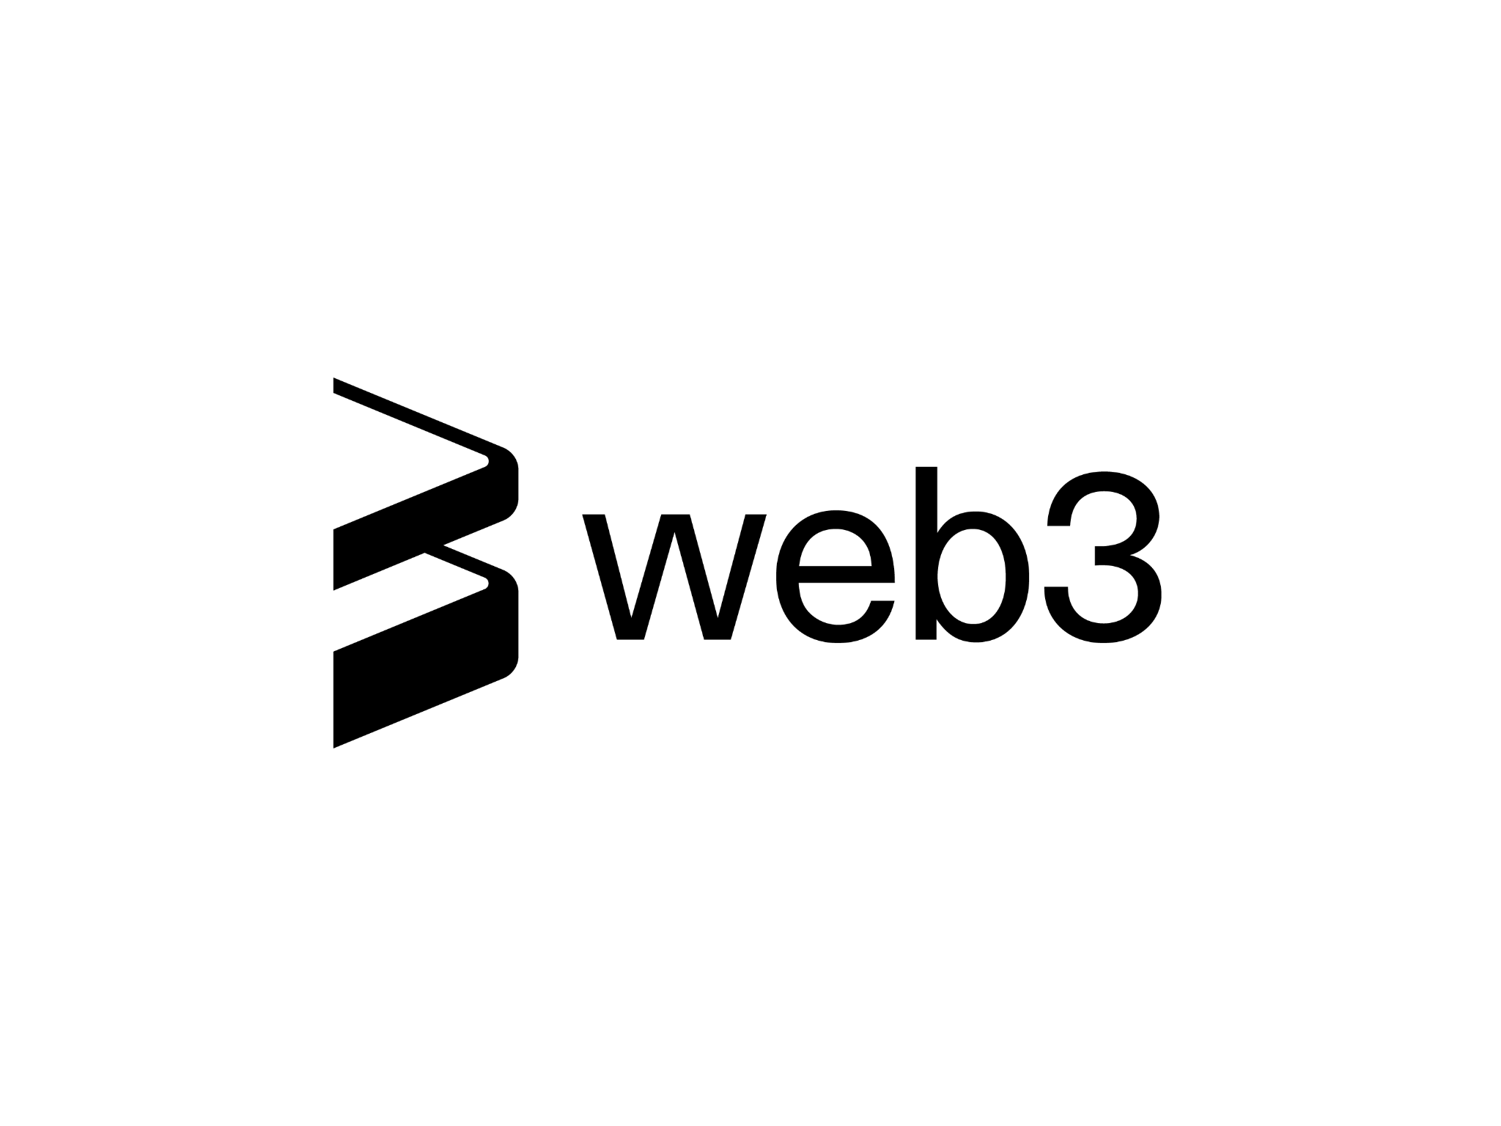
The Insane Future of Web 3.0 and the Metaverse
Getting Ready for the
Next Generation of the Internet
www.piaic.org
Syllabus: www.panaverse.co

Slide 2
Table of Content:
Module 1: History Of Internet and Evolution
Module 2: Web 3.0 and Metaverse
Module 3: A Glimpse of Digital World
Module 4: PIAIC ‘A Disruptor in Pakistan IT industry’

Slide 3


What is the most significant invention in human history?
Without these inventions, life would not be the same for us.

Slide 4
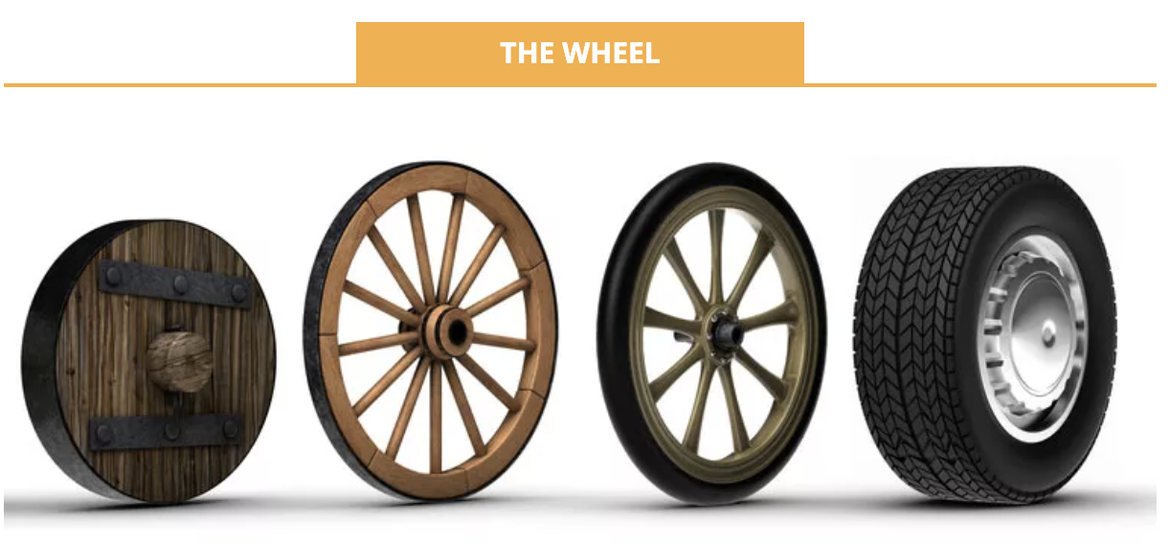

Slide 5
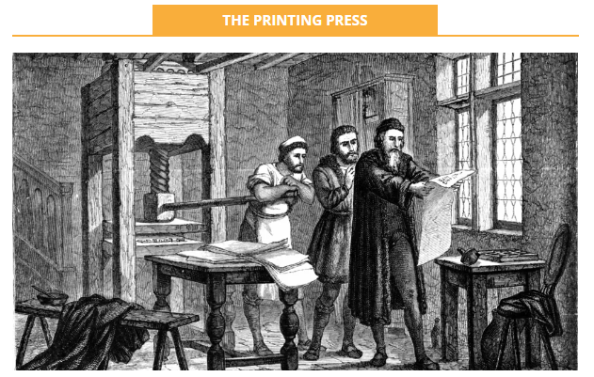

Slide 6
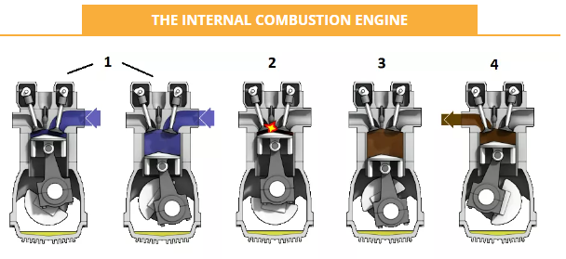

Slide 7
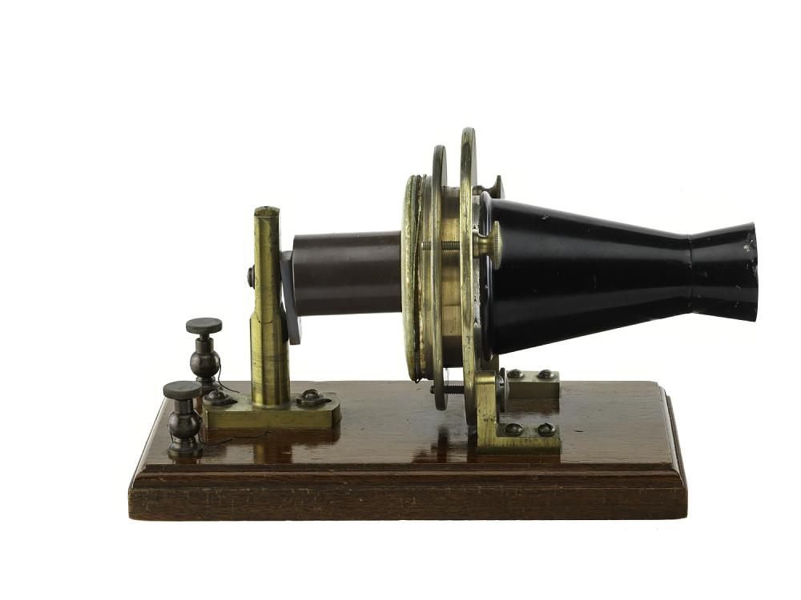
Notes:
Telephone that connects everyone around the globe.

Slide 8
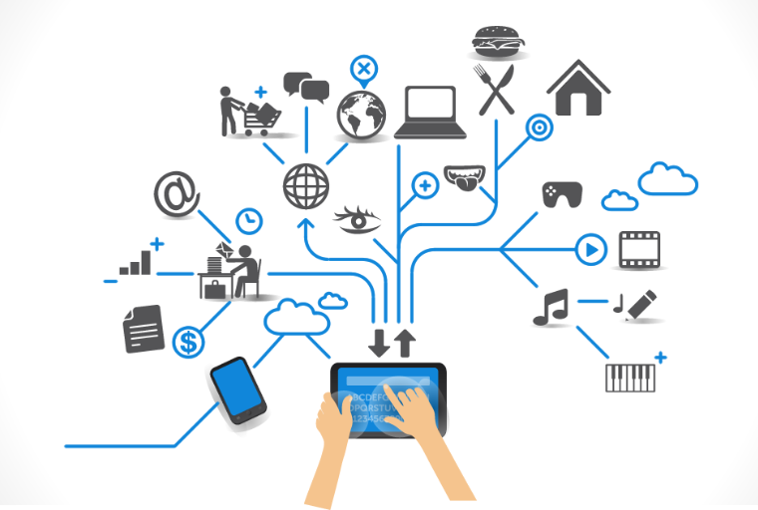
Notes:
The internet that is the required now in our daily usage.

Slide 9
Without a question, the Internet is the most important technological advancement in human history.
Notes:
Without any doubt our answer is internet
Q: Why is internet is so important?
Ans: now a days internet is used to find any information,
Or for communication purpose
or to manage our finances,
Listen to music watch videos and much more

Slide 10
Internet is a Recent Innovation
The internet is a global system of interconnected computer networks that is used by billions of people worldwide.
In 1960 - First version of internet (ARPANET) was created by group of scientists working for ARPA of U.S Defense Department.
In 1989 - Internet Evolved Further from the invention of WWW by computer scientist Tim Berners Lee while working at CERN
Core Idea of WWW - Combining the evolving technologies of computer, data networks and hypertexts into global information system.
Development of WWW - it connected the world in a way that it had never been before.
Notes:
Story start from the 1960 when the first version of the internet was launched
QnA
What is the purpose of www that we see today in website URL? Anyone

Slide 11
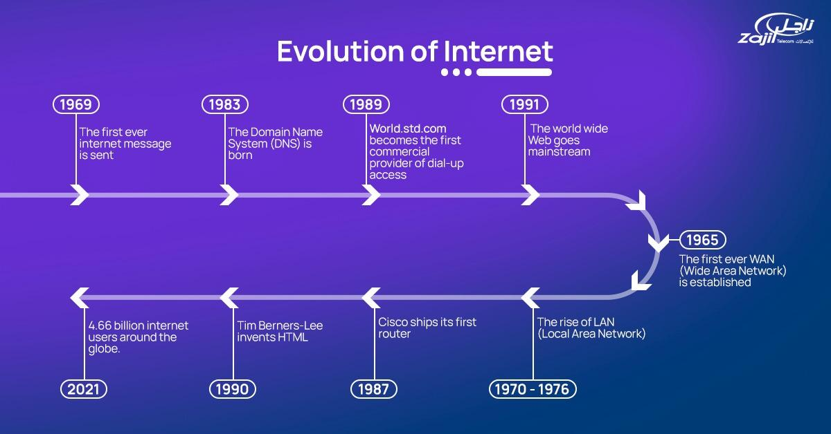

Slide 12
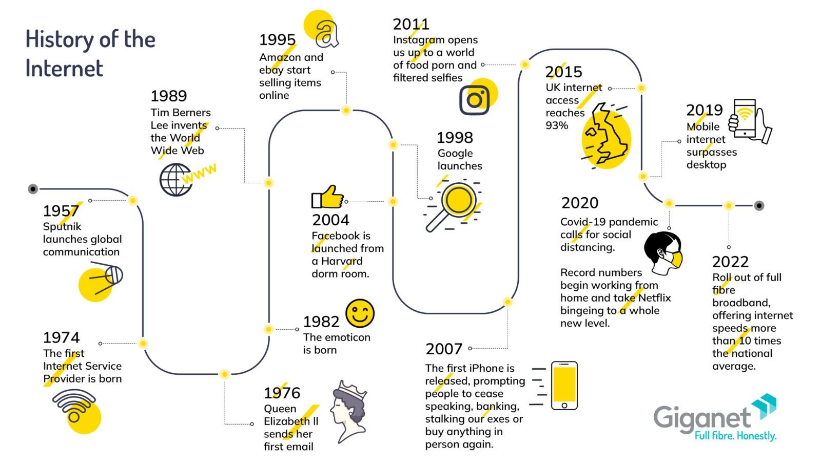
Notes:
We can see the evolution of the internet gradually from the 1957 to till now and it got boom during COVID period when almost all companies and work shifted to it and in present we have 10x more powerful internet speed that it was used to be before

Slide 13
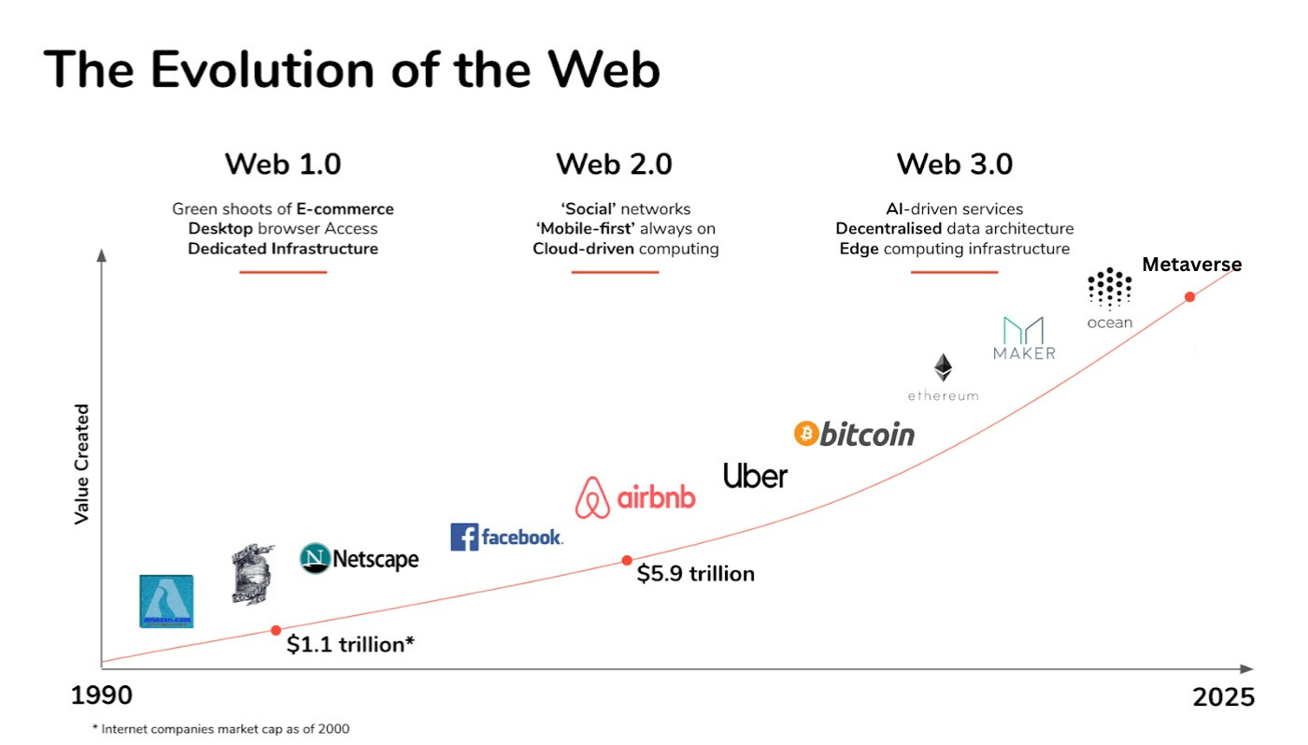
Notes:
Web 1.0 - static pages, user is consumer
Web 2.0 - pros: user consume information and produce information
QnA: What is the problem with web 2.0?
Cons: data is in hand of centralized companies that used our data for their services without user consent.
Web 3.0 - user own the data and no middle man - user has ownership and decision power
Web 3.0 is build by the distributed system and with the help of blockchain technology

Slide 14
We are just scratching the surface of what it can do for us
Improved Internet - Web 3.0 and Metaverse will add the new features and enhancements.
Reconceptualized Web - Metaverse reimagines the front-end and Web 3.0 reimagines the back-end of the web.
Interconnection of Web 3.0 and Metaverse - Both will work together and complement each other.
Concerns behind Web 3.0 and Metaverse - Web 3.0 is primarily concerned with who will own and rule the internet of the future whereas, Metaverse is more focus about how users will interact using 3D, AR, VR
Kinds of Metaverse - Virtual Metaverse will be for short duration usage and Augmented Metaverse will revolutionize the society.
Notes:
Metaverse reimagined the user experience and web 3.0 is reimagined the site structure and system
Web 3.0 focuses on the new internet whereas the metaverse focused to enhance the user experience through mixed reality.
QnA Who are more keen towards gaming like pubg, roblox or sandbox. Anyone from audience?

Slide 15
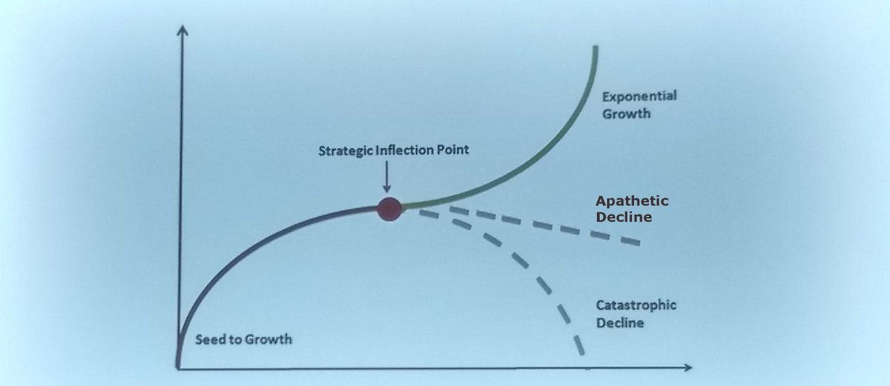
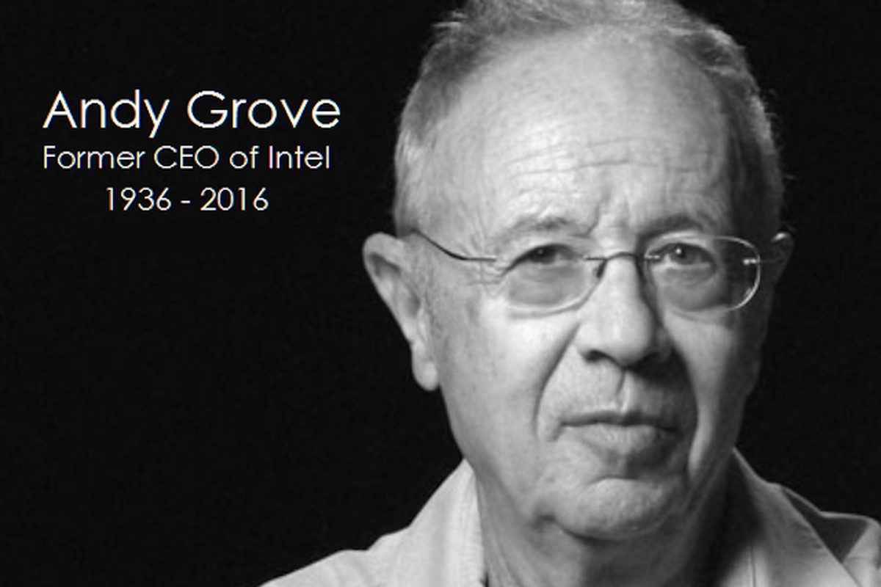
Adapt or perish, now as ever, is nature’s inexorable imperative
Strategic Inflection Point
Notes:
It is a state of adopte a new technology or letting it go. So it is more like now or never. We have to take risk.
HG Wells famously wrote in 1945 that “Adapt or perish, now as ever, is nature’s inexorable imperative.”

Slide 16
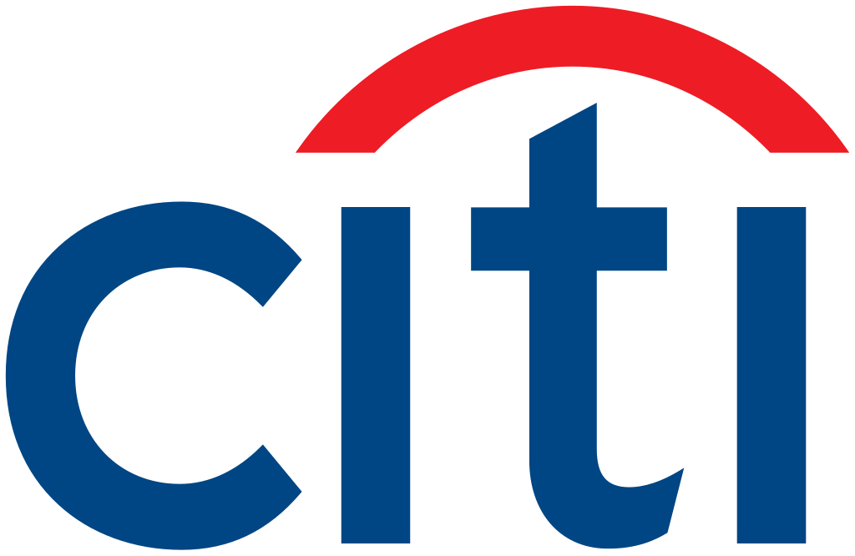
13 Trillion
Citi estimates that total addressable market for the Metaverse and Web 3.0 Economy could grow from $8 Trillion to $13 Trillion with 5 billion unique global users by 2030.
Metaverse and Money: Decrypting the Future
Notes:
QnA: Who don’t want to be millionaire here?
https://www.citivelocity.com/citigps/metaverse-and-money/

Slide 17
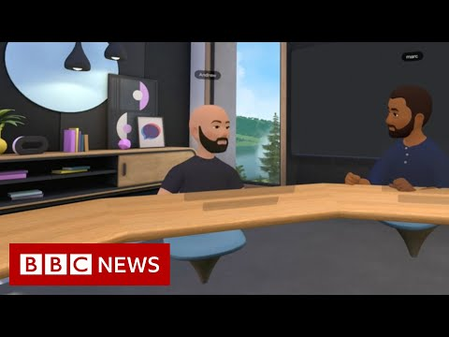
What is the Metaverse?

Slide 18

—Matthew Ball
“The future of the internet: A massively-scaled, persistent, interactive, and interoperable real-time platform comprised of interconnected virtual worlds where people can socialize, work, transact, play, and create.”
The Metaverse: And How it Will Revolutionize Everything
Notes:
Under the umbrella of metaverse we have multiple technologies lies in it like persistency, interoperability and real-time rendering. Example of game
After creating a disruption. It rewind back to its original state

Slide 19
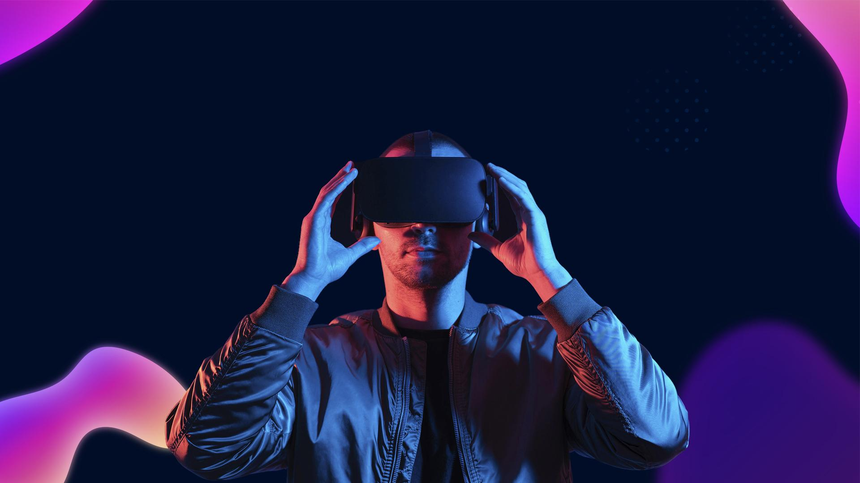
“The metaverse is a 3D version of the Internet and computing at large.”

Slide 20
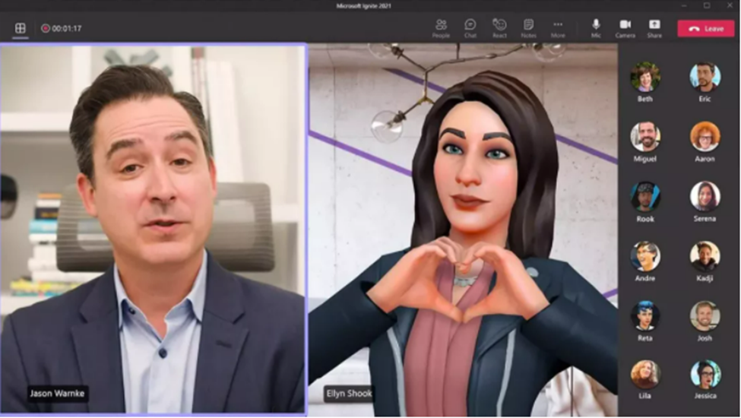
Expression:
In the Metaverse, each user will have an Avatar, a fully multidimensional living depiction of themselves that can be customised to their choice.
These Avatars will be rendered with every real feature of user and give sense of reality.

Slide 21
Teleportation
Knowledge
Productivity
For so long, science has been attempting to achieve teleportation
With Metaverse, users can now teleport miles away with the blink of an eye.
Libraries are becoming obsolete as "googling" becomes more popular. But now in Metaverse user will be able to learn by just touching and looking them, a whole new revolution in educational industry.
We moved from pen to keyboard. Metaverse will make it happen for its users to input commands by using voice gestures or even by thinking about them. You could send message just by thinking and moving your fingers.
Notes:
Knowledge Subject: Astronomy

Slide 22

Gross Metaverse Product (GMP)
UAE’s economic success to be measured using ‘Gross Metaverse Product’ instead of GDP
Minister of State for Artificial Intelligence, at Emirate’s Metaverse Strategy at the Dubai Metaverse Assembly
Wed 28 Sep 2022
Notes:
https://www.khaleejtimes.com/uae/uaes-economic-success-to-be-measured-using-gross-metaverse-product-instead-of-gdp-top-official

Slide 23
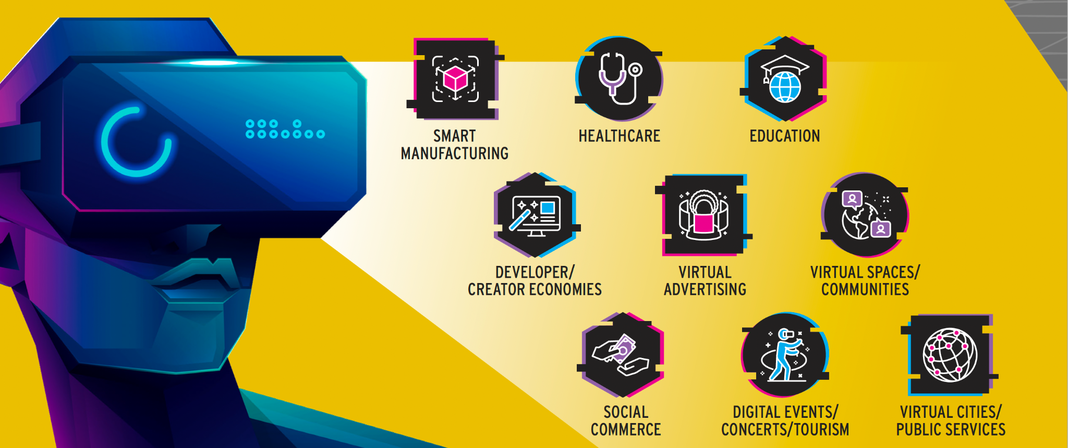
Metaverse Use Cases
Notes:
Immersive features / branding / virtually travel everywhere (real-time feel) - gadgets in making where you can feel and smell things / interoperability (the ability of different systems, devices, applications or products to connect and communicate in a coordinated way, without effort from the end user)

Slide 24
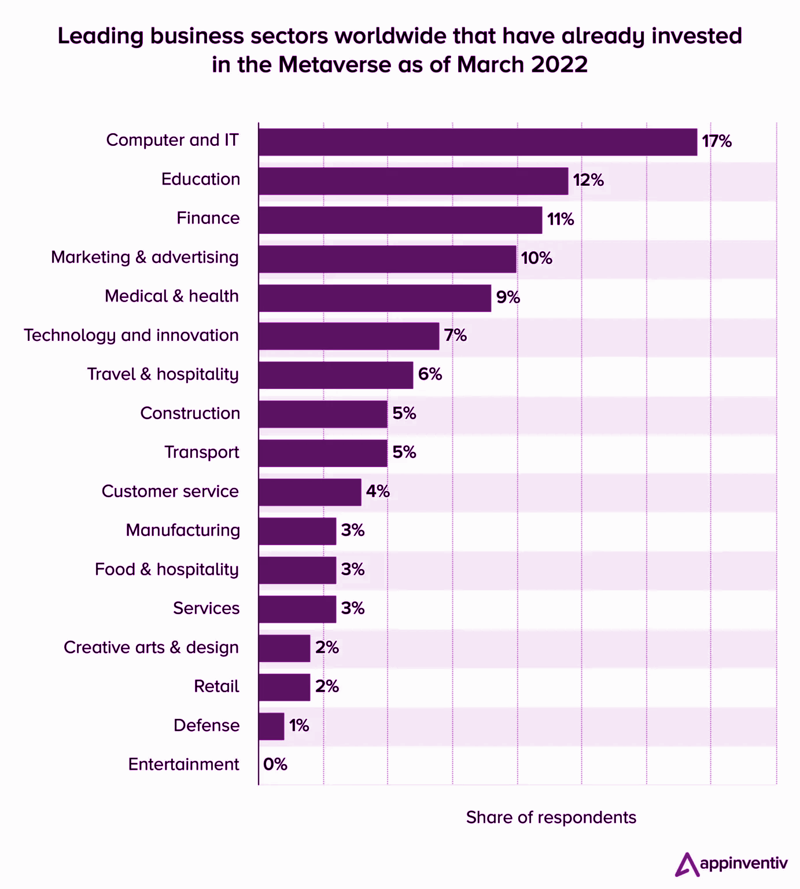
Metaverse Use Cases
Notes:
More than 17% of global IT enterprises have already invested in Metaverse.

Slide 25
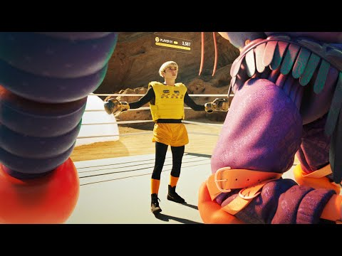
Facebook’s Vision for Metaverse

Slide 26
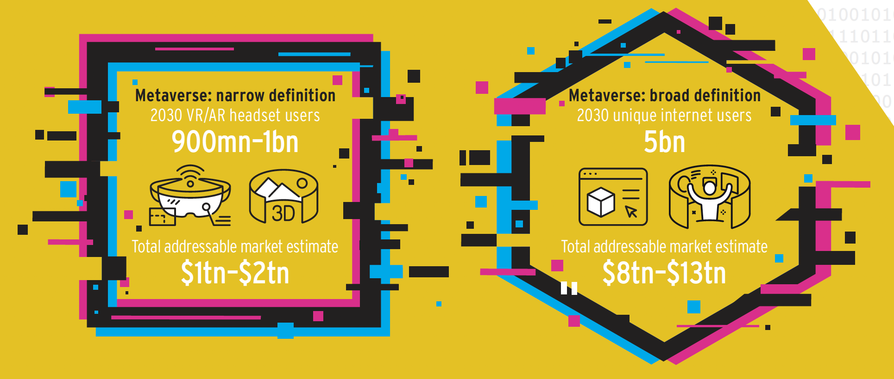
Metaverse Market Potential
Notes:
Differentiating between VR and AR? Mixed realities
Computer technology to create a simulated environment, a 3D experience (immersive one)
AR is different from VR because it adds to the real-world experience rather than creating a new experience from scratch.
Augmented reality (AR) enhances users’ real-world views with digital overlays that incorporate artificial objects.
You can use all your senses infact in metaverse

Slide 27
Money in the Metaverse
The Metaverse will include existing forms of payments such as credit cards with Fiat money.
In addition, new forms of payments will be accepted:
Cryptocurrency & Tokens
Stablecoins
Central Bank Digital Currencies (CBDCs)
Notes:
Economy has to run with money and in digital economy that has to be digital money

Slide 28
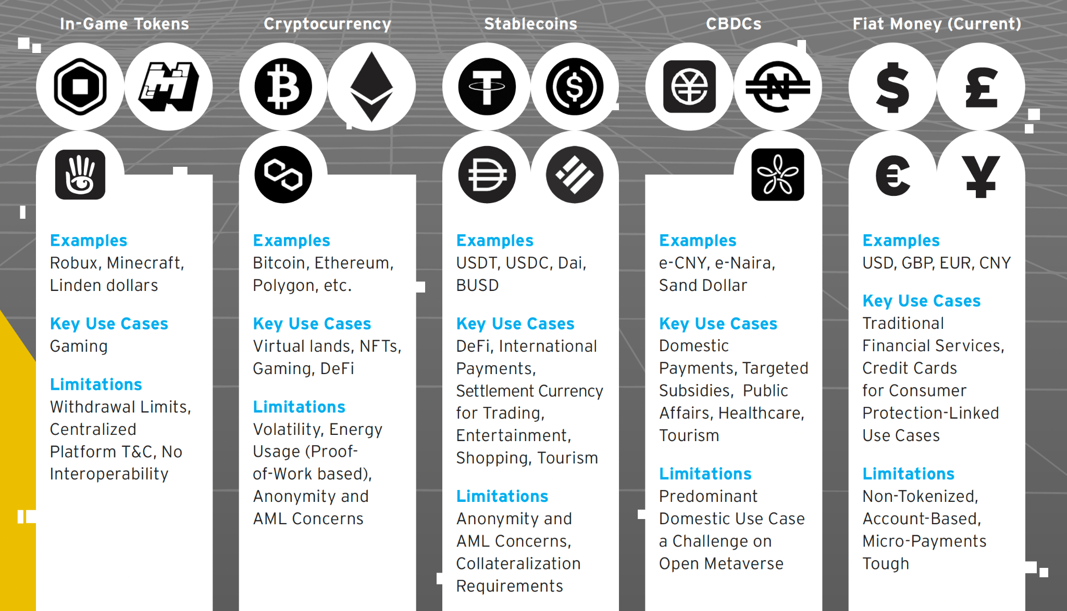
Metaverse Money
Notes:
You can keep all types of assets in your wallet. Like fiat currency, crypto’s, nfts etc. trade them fully or partially.
https://bankingblog.accenture.com/why-money-in-the-metaverse-is-a-huge-opportunity-for-banks

Slide 29
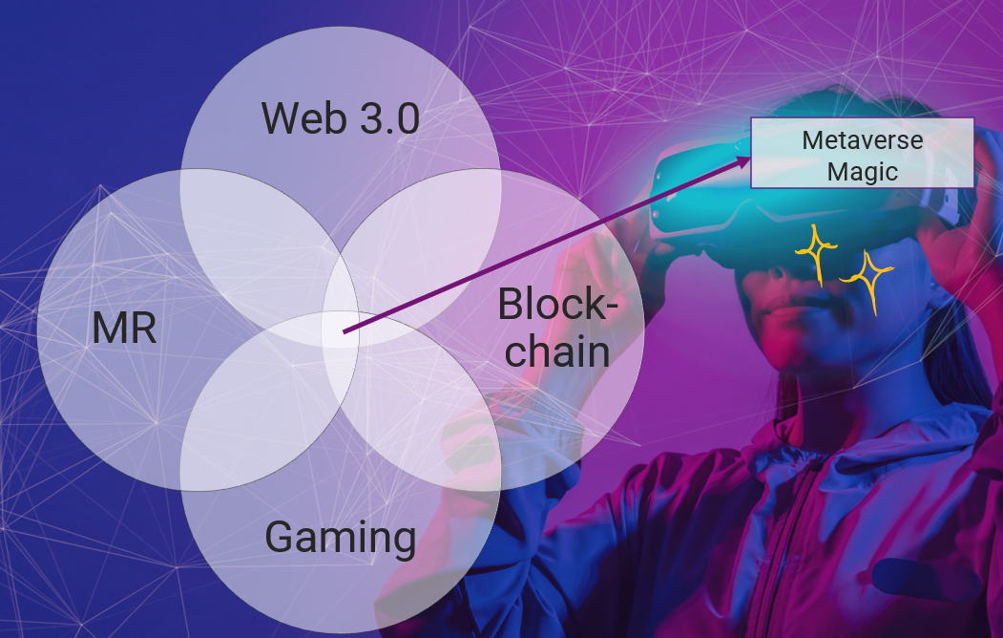
What does Web 3 have to do with Metaverse?
Based on ownership and decentralization and facilitated via blockchain, Web3 refers to the conceptual third iteration of the internet.
The so-called “Open Metaverse” is built upon blockchain — mainly the Ethereum chain — and overlaps with Web3.
Many Web2 centralized platforms will play an important role in the Metaverse, and even Web3 today relies on elements of centralization.

Slide 30
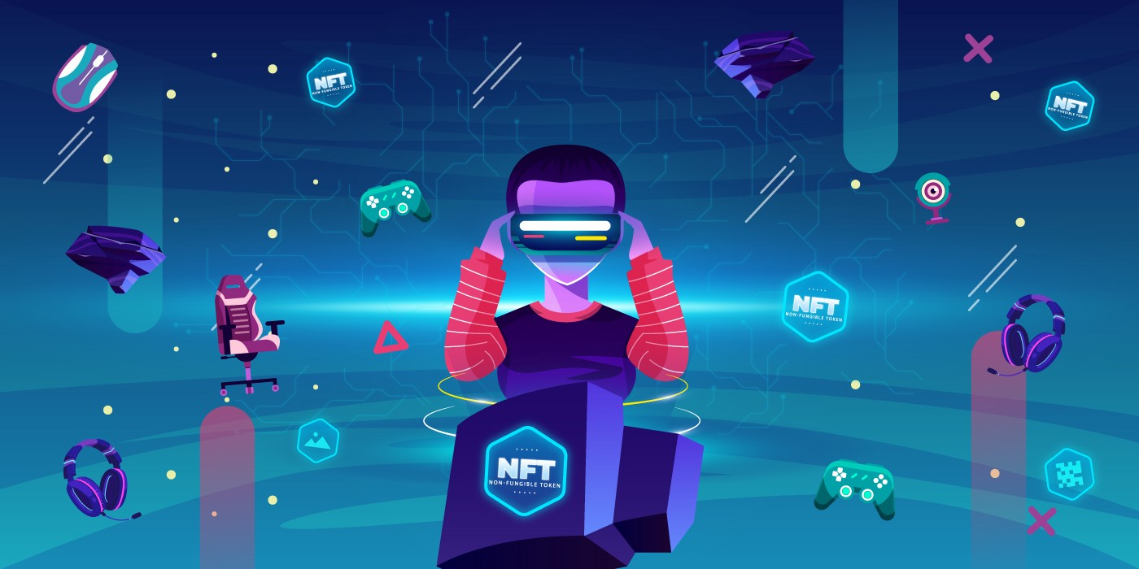
What’s the Role of NFTs in the Metaverse?
NFTs in the Metaverse enable a form of sovereign ownership for users/owners and are
Tradeable
Composable
Immutable
Mostly interoperable
Notes:
Increased interest from gamers, investors, and corporates in the NFT space in recent months. NFTs in the Metaverse are virtual items stored in a digital wallet that can be taken everywhere within the Metaverse.

Slide 31
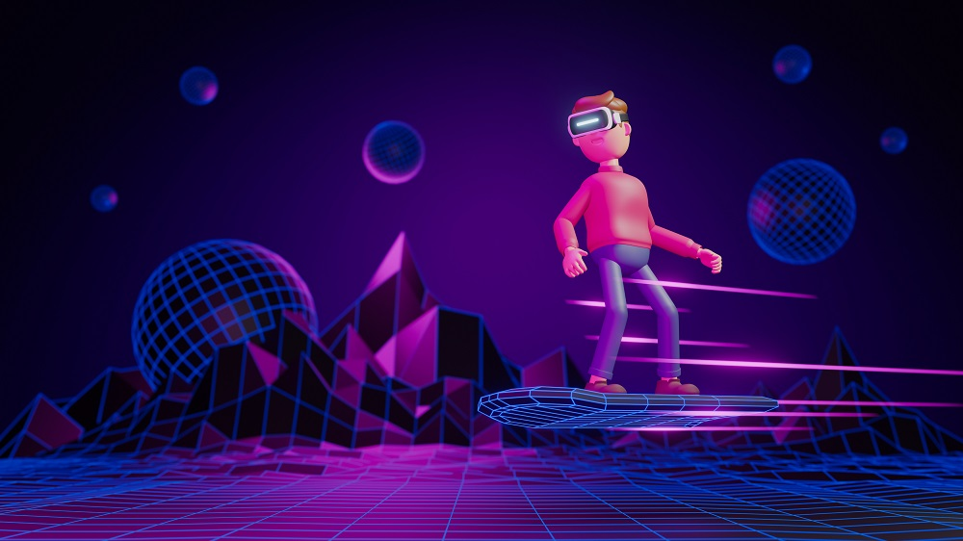
What’s the Role of AI in the Metaverse?
AI for immersive digital worlds
AI as a creative partner
Intelligent networking
Smart hyper-personalized games, experiences, education and welfare
Notes:
Siri, Alexa, self-driving cars, conversation chatbots, and even Netflix recommendations are all examples of artificial intelligence systems in today's world.
"AI is the new electricity." Though there's no single definition to the term AI, it is often presented as a subfield of computer science and machine learning that aims at developing algorithms and models in a way that mimics the human way of thinking.
ChatGPT, the new language processing AI from OpenAI, is making waves in the tech industry. The advanced model, which is trained to generate human-like text, is already being hailed as a game-changer for businesses that rely on natural language processing

Slide 32
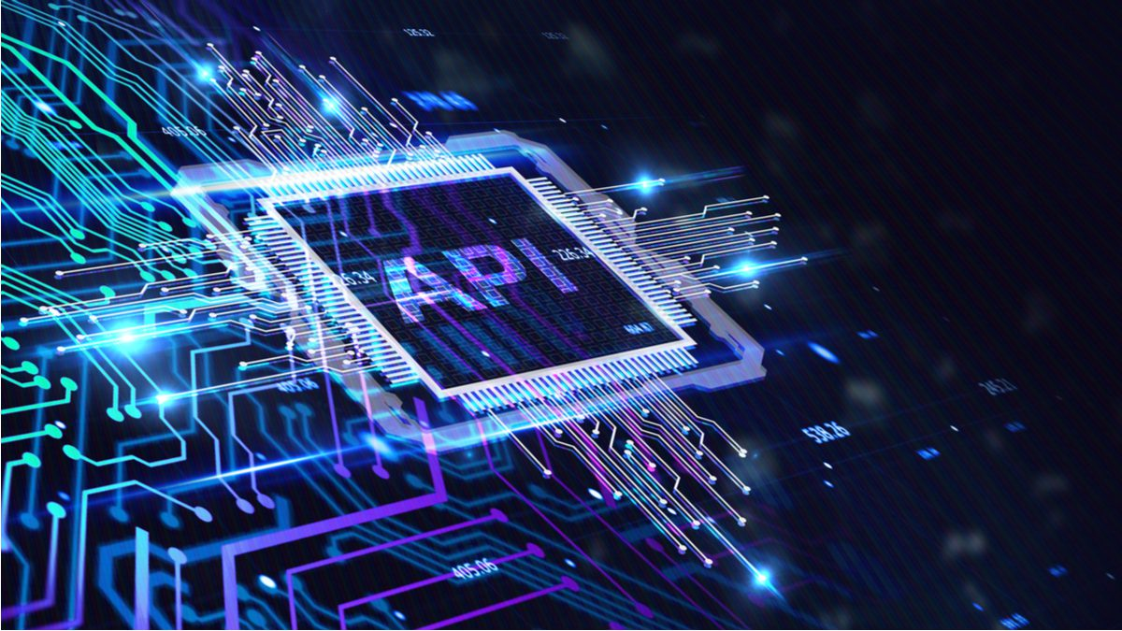
What’s the Role of APIs in the Metaverse?
APIs will:
Help create the Metaverse.
Speed up immersive experiences development time and cut costs.
Be used by Metaverse Developers to change product code without needing to start from scratch.
Be a fundamental building block of Metaverse, Web 3.0 and the future of the internet.
Notes:
API is the acronym for application programming interface –– a software intermediary that allows two applications to talk to each other. APIs are an accessible way to extract and share data within and across organizations.
Examples: YouTube API - Allows you to display videos on a web site. Twitter API - Allows you to display Tweets on a web site. Facebook API - Allows you to display Facebook info on a web site.

Slide 33

What’s the Role of Cloud Computing in the Metaverse?
The essence of the Metaverse is still cloud computing.
Scalable AI and APIs can only be built economically on the cloud.
Only Serverless Cloud Computing can meet the scalability requirements of the Metaverse.
What Metaverse itself needs is computing, storage, machine learning, etc., which are inseparable from cloud computing.
The architecture of Metaverse will be event-driven which means it will be a Serverless Metaverse.
Notes:
What Metaverse itself needs is computing, storage, machine learning, etc., which are inseparable from cloud computing.The architecture of Metaverse will be event-driven which means it will be a Serverless Metaverse. Examples would include: Dropbox, a file storage and sharing system.
The cloud provides a number of IT services such as servers, databases, software, virtual storage, and networking, among others. In layman's terms, Cloud Computing is defined as a virtual platform that allows you to store and access your data over the internet without any limitations.

Slide 34
Practical
Digital Wallet i.e MetaMask
Create Token
Uniswap
Etherscan

Slide 35
Global Tech Talent Shortage
The global talent shortage already amounts to 40M skilled workers worldwide.
By 2030, the global talent shortage is predicted to reach 85.2M workers. Сompanies worldwide risk losing $8.4T in revenue because of the lack of skilled talent.
According to a CNBC report, the software developer shortage is alarming in 2022. The rate of unfilled IT jobs in USA increased to 918,000 vacancies at the end of 2021.
Another report noted that by 2030, the number of software job vacancies would rise by almost 22%. The average growth rate of software developers in the USA is only 8% right now, and that clearly emphasizes there is already an overwhelming and severe shortage of skilled workers.
85 Million
By 2030

Slide 36
So who will build the Metaverse?

Slide 37
A Global Mass Developer Training Program will Solve the Talent Shortage

Slide 38

Panaverse is Unlike Any Other Program

Slide 39








Developer Skill Set: Web2
TypeScript
VS Code
Next.js
Terraform CDK
Serverless
CLI
Frontend & Backend Development
Integrated Development Environment
Front End Development Framework
Infrastructure as Code
AWS Lambda, API Gateway, AppSync, and Aurora for API Development
Panacloud CLI for API Development

Slide 40
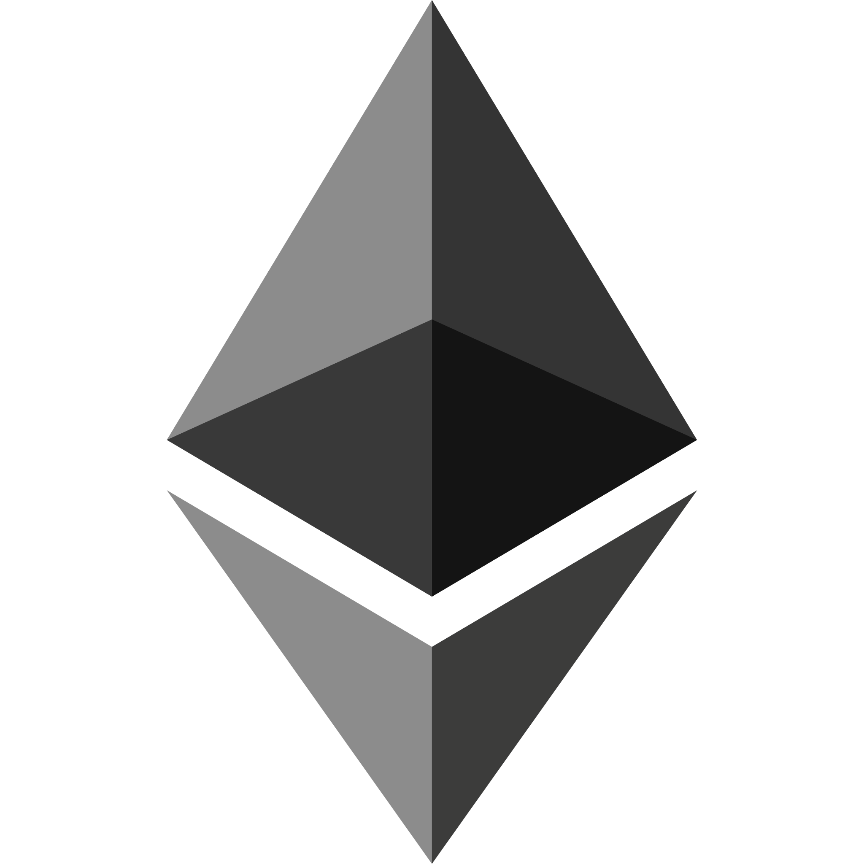
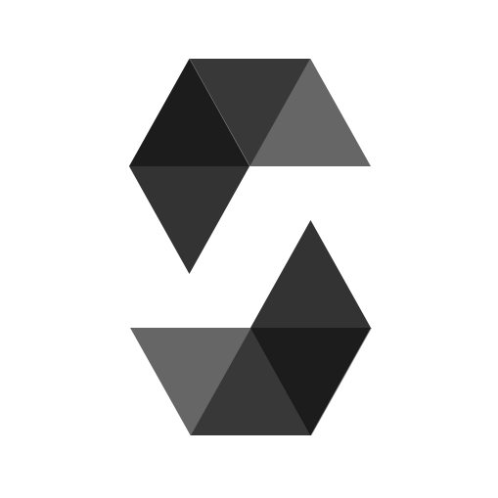




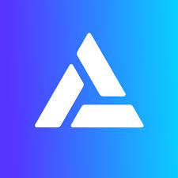

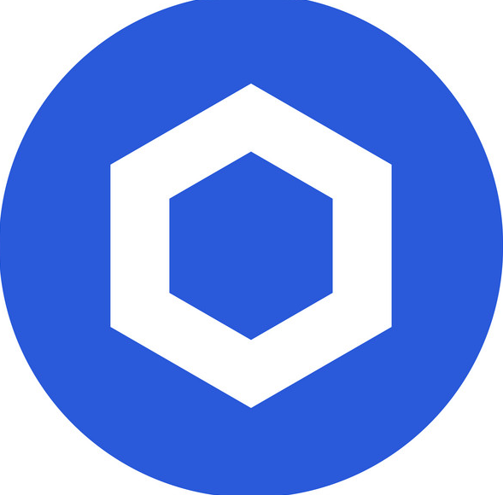
Developer Skill Set: Web3
Ethereum
Solidity
OpenZeppelin
Hardhat
Ethers.js
Metamask
Alchemy
The Graph
Chainlink

Slide 41

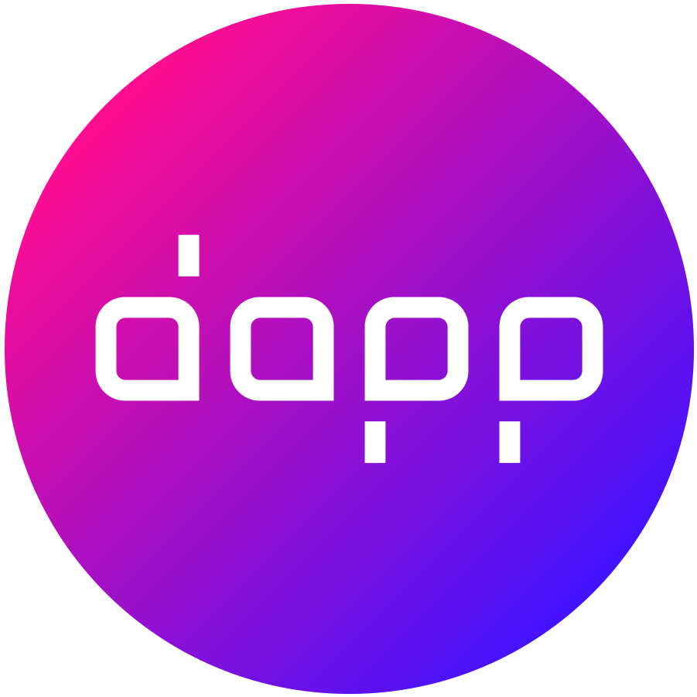
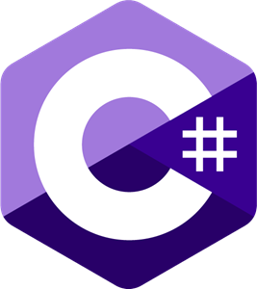
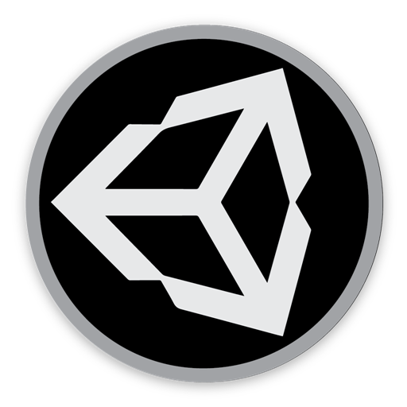

Developer Skill Set: 3D
WebGPU
WebXR
DAPP
C#
Unity 3D
Blender
Three.js - JavaScript 3D Library
Three.js - JavaScript 3D Library
Designing Metaverse DAPP Experiences
Unity XR Programming
3D Development Platform
3D Modeling

Slide 42
Panaverse DAO
A decentralized autonomous organization (DAO) is an emerging form of legal structure that has no central governing body and whose members share a common goal to act in the best interest of the entity.
Panaverse DAO will be a hybrid of a business entity and an educational institution for all Web 3 and Metaverse Developers.
www.panaverse.dao

Slide 43
What is a DAO?
A decentralized autonomous organization is an entity structure in which token holders participate in the management and decision-making of an entity.
There is no central authority of a DAO; instead, power is distributed across token holders who collectively cast votes.
All votes and activity through the DAO are posted on a blockchain, making all actions of users publicly viewable.
The concept of a DAO is to promote oversight and management of an entity similar to a corporation. However, the key to a DAO is the lack of central authority; the collective group of leaders and participants act as the governing body.
Notes:
https://www.investopedia.com/tech/what-dao/

Slide 44
How DAOs Work?
The voting process for DAOs is posted on a blockchain. Users must often select between mutually-exclusive options.
Voting power is often distributed across users based on the number of tokens they hold.
For example, one user that owns 100 tokens of the DAO will have twice the weight of voting power over a user that owns 50 tokens.
The theory behind this practice is users who are more monetarily invested in the DAO are incentivized to act in good faith.
DAOs often have treasuries that house tokens that can be issued in exchange for fiat.

Slide 45
Panaverse Community
The concept of a Panaverse DAO will encourage people from all over the world to seamlessly come together to build a single Web 3 and Metaverse vision. With just an internet connection, token holders can interact with other owners wherever they may live.
www.panaverse.co

Slide 46
We Will Help You
We have Extensive Experience of Conducting Mass Training Programs. Currently, we are running the President of Pakistan’s Initiative for AI & Computing (PIAIC). We can help join this revolution.
www.piaic.org

Slide 47
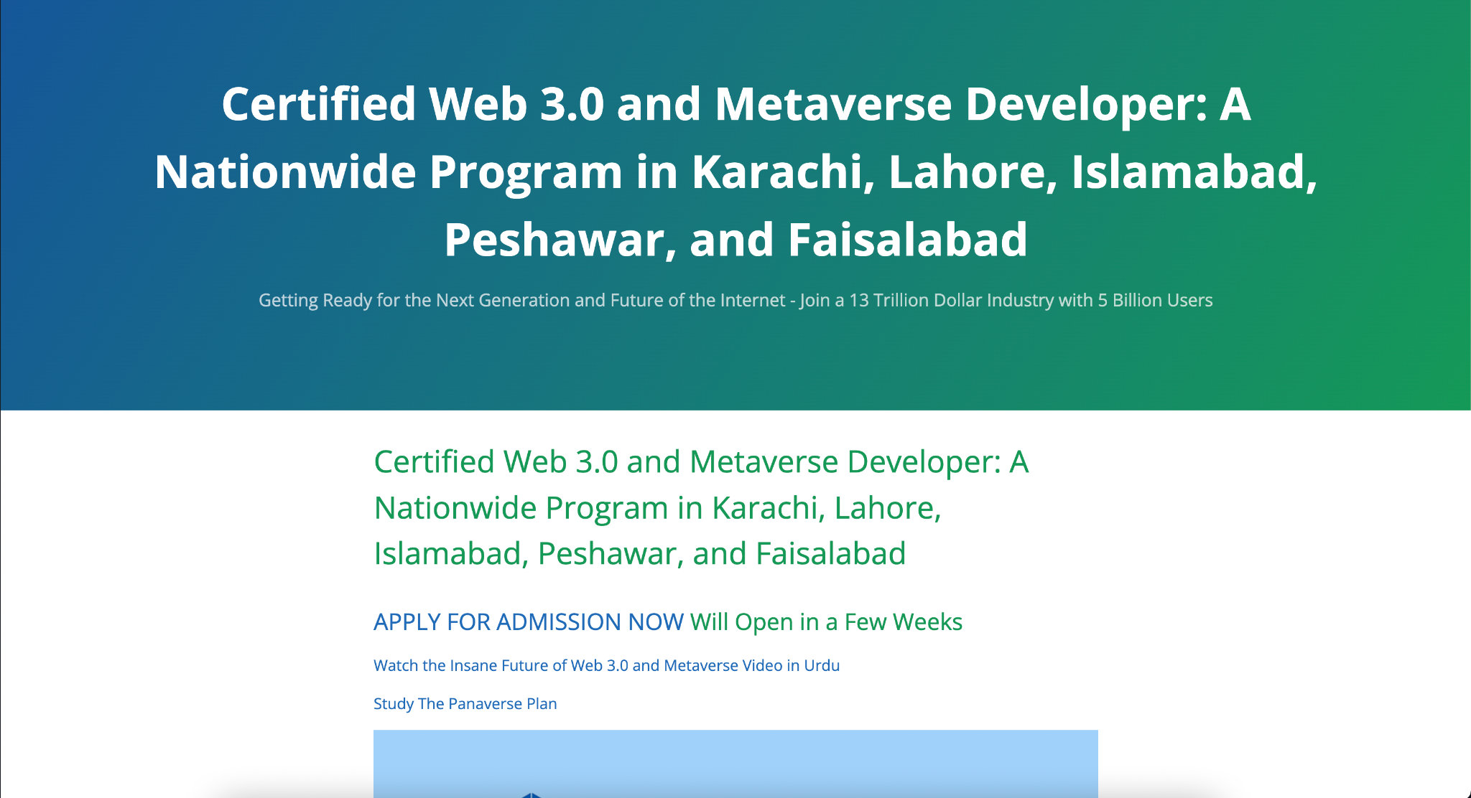
Panaverse:
Certified Web 3.0 & Metaverse Developer
www.panaverse.co
https://discord.gg/GggDkBwJDr
https://twitter.com/Panaverse_edu
https://www.facebook.com/groups/panaverse

